Slide 1
(demo)

Slide 2
DoodleDebug
better than toString()

Slide 3
Why?
2-dimensional (with nesting!)
Colors
Formatting

Slide 4
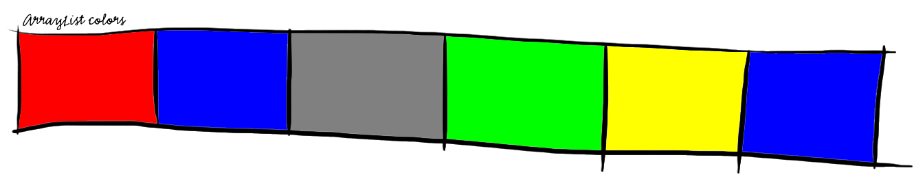
Why?
[java.awt.Color[r=255,g=0,b=0], java.awt.Color[r=0,g=0,b=255], java.awt.Color[r=128,g=128,b=128], java.awt.Color[r=0,g=255,b=0], java.awt.Color[r=255,g=255,b=0], java.awt.Color[r=0,g=0,b=255]]
versus

Slide 5
Features
Built-in renderings for common data types
(Array, List, Color etc.)

Slide 6
Features
Default rendering for every (non-common) object type, i. e. rendering for type object

Slide 7
Features
Expandable:
Plugins for own data types
public class MyPlugin extends AbstractPlugin

Slide 8
Design process
Analyzing usage of printOn: in SqueakSource:
590 of 2145 projects override printOn: methods
(2688 printOn: methods)
77 % percent include own class name!
ASCII-graphics are made (e.g. for matrices)

Slide 9
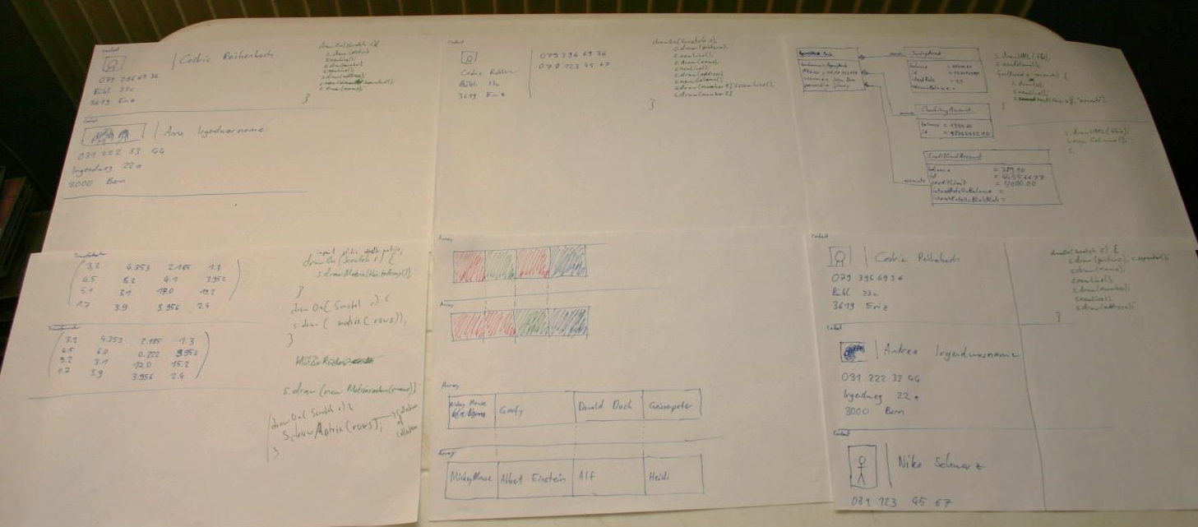
Design process
Sketching visualizations and
corresponding code snipplets

Slide 10
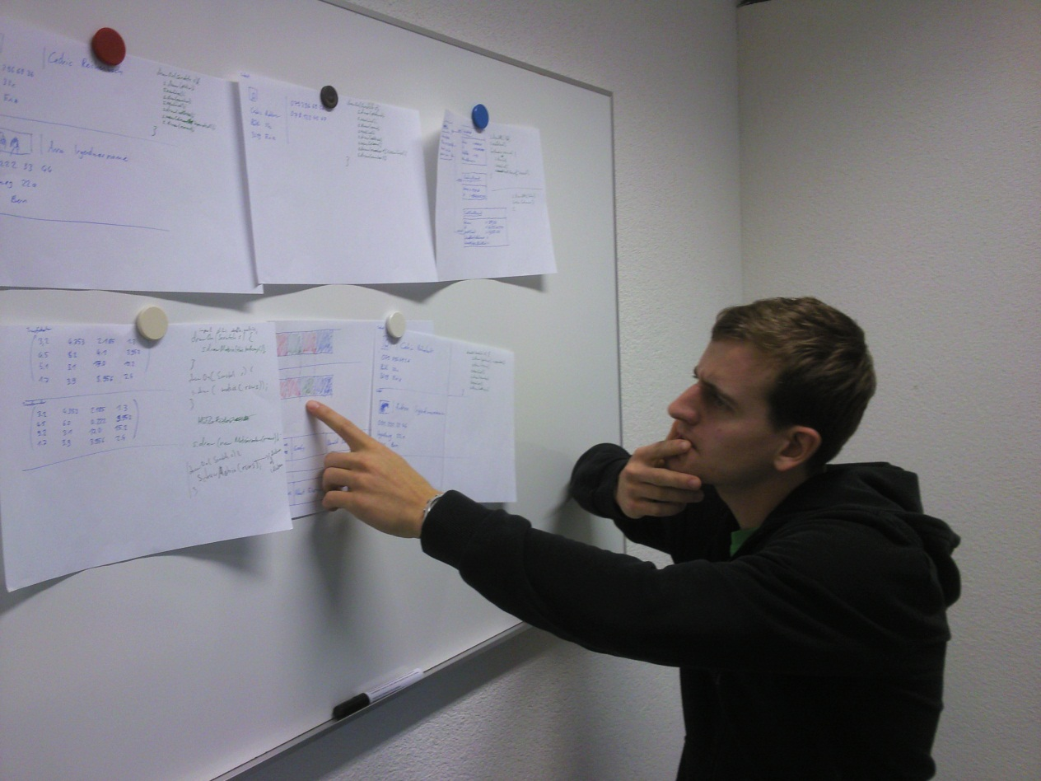
Design process
Talk to developers

Slide 11
Related work
Paper: «Let's go to the whiteboard: how and why software developers use drawings» main statement: Whiteboard → Computer Screen is too expensive

Slide 12
Related work
Zest: An Eclipse Visualization Toolkit, not debug-oriented, not very simple
DataDisplayDebugger: Graphical front-end for existing command-line debuggers
Moose

Slide 13
TODO:
More built-in renderings
Building Eclipse-Plugin
Use JavaScript to improve rendering (e. g. align corresponding components)

Slide 14
Schedule
May 2012: Working Eclipse Plugin (& JavaScript)
July 2012: Paper finished
August 2012: Paper hand-in

